Slide 1


P
Session 1
Eman Raslan

Slide 2

Course RoadMap
Session 1
Lab 1
Lab3
Project Deliver
Session 2
Lab 2

Slide 3
Data Visualization in Data Science
The First Mile …
… and the Last Mile.
Data Exploration, Exploratory Data Analysis
Communication, Explanation, Operationalization
Making many interactive graphics quickly for:
‘Getting a sense’ of the data.
Looking for patterns & outliers.
Validating data quality.
Making fewer, more polished interactive graphics for:
Publication in articles or on the web.
Non-data- scientists to interact with outputs.
Making models actionable.
Notes:
AI analytics identifies trends and provides correlations in real time
Instead of long investigations and analysis through multiple business KPI dashboards and making manual correlations, business analysts can rely on AI analytics to probe deeper into the data and correlate simultaneous anomalies, revealing critical insights into operations.
A real-time, large-scale automated anomaly detection system using machine learning methods can free data analysts from constant manual monitoring around just a few KPIs.
Artificial intelligence (AI) represents the next step in unlocking value from data. AI can not only enable enterprises to better understand current business conditions, but also to predict what will happen in the future and take actions based on those predictions. Today, an increasing number of business users and analysts without formal data science training are harnessing the predictive power of AI through what’s become known as augmented analytics. By automating the simplest parts of the machine learning (ML) process, augmented AI extends model building to a broader range of users including business people, analysts, and developers.
Aible’s ML algorithms leverage a company's data sources to deliver specific recommendations. With Aible, you can embed AI models, predictions, and recommendations directly in the Tableau dashboard. Let’s take a look at a use case for sales opportunity optimization.

Slide 4
Session Milestone
What is Data Visualization?
Why do we need Data Visualization ?
How do We Visualize Data?
Dangers of Data Visualization?
Notes:
? o Graphical representation o Once reserved to smaller groups (company boards), DV evolved greatly - Browsing “real world” examples and showing why/how bad/good they are. o Focus on: ▪ presence of title ? (correctness) • sometimes the title does not match the data ▪ presence of an explanation ? (correctness) ▪ presence of scale and legend ▪ origin of data • level of confidence • references are present ▪ sample size ▪ date of publication (was there noticeable events after) ▪ palette • choice of range or colors –
o Propaging false ideas quickly o blind acceptance (see Milgram experiment) ▪ many readers will browse the title, glance at the picture and not read the eventual explanations paragraph ▪ data coming from a separate provider will benfit from the reputation of the media (website, newspaper) it is published in.

Slide 5
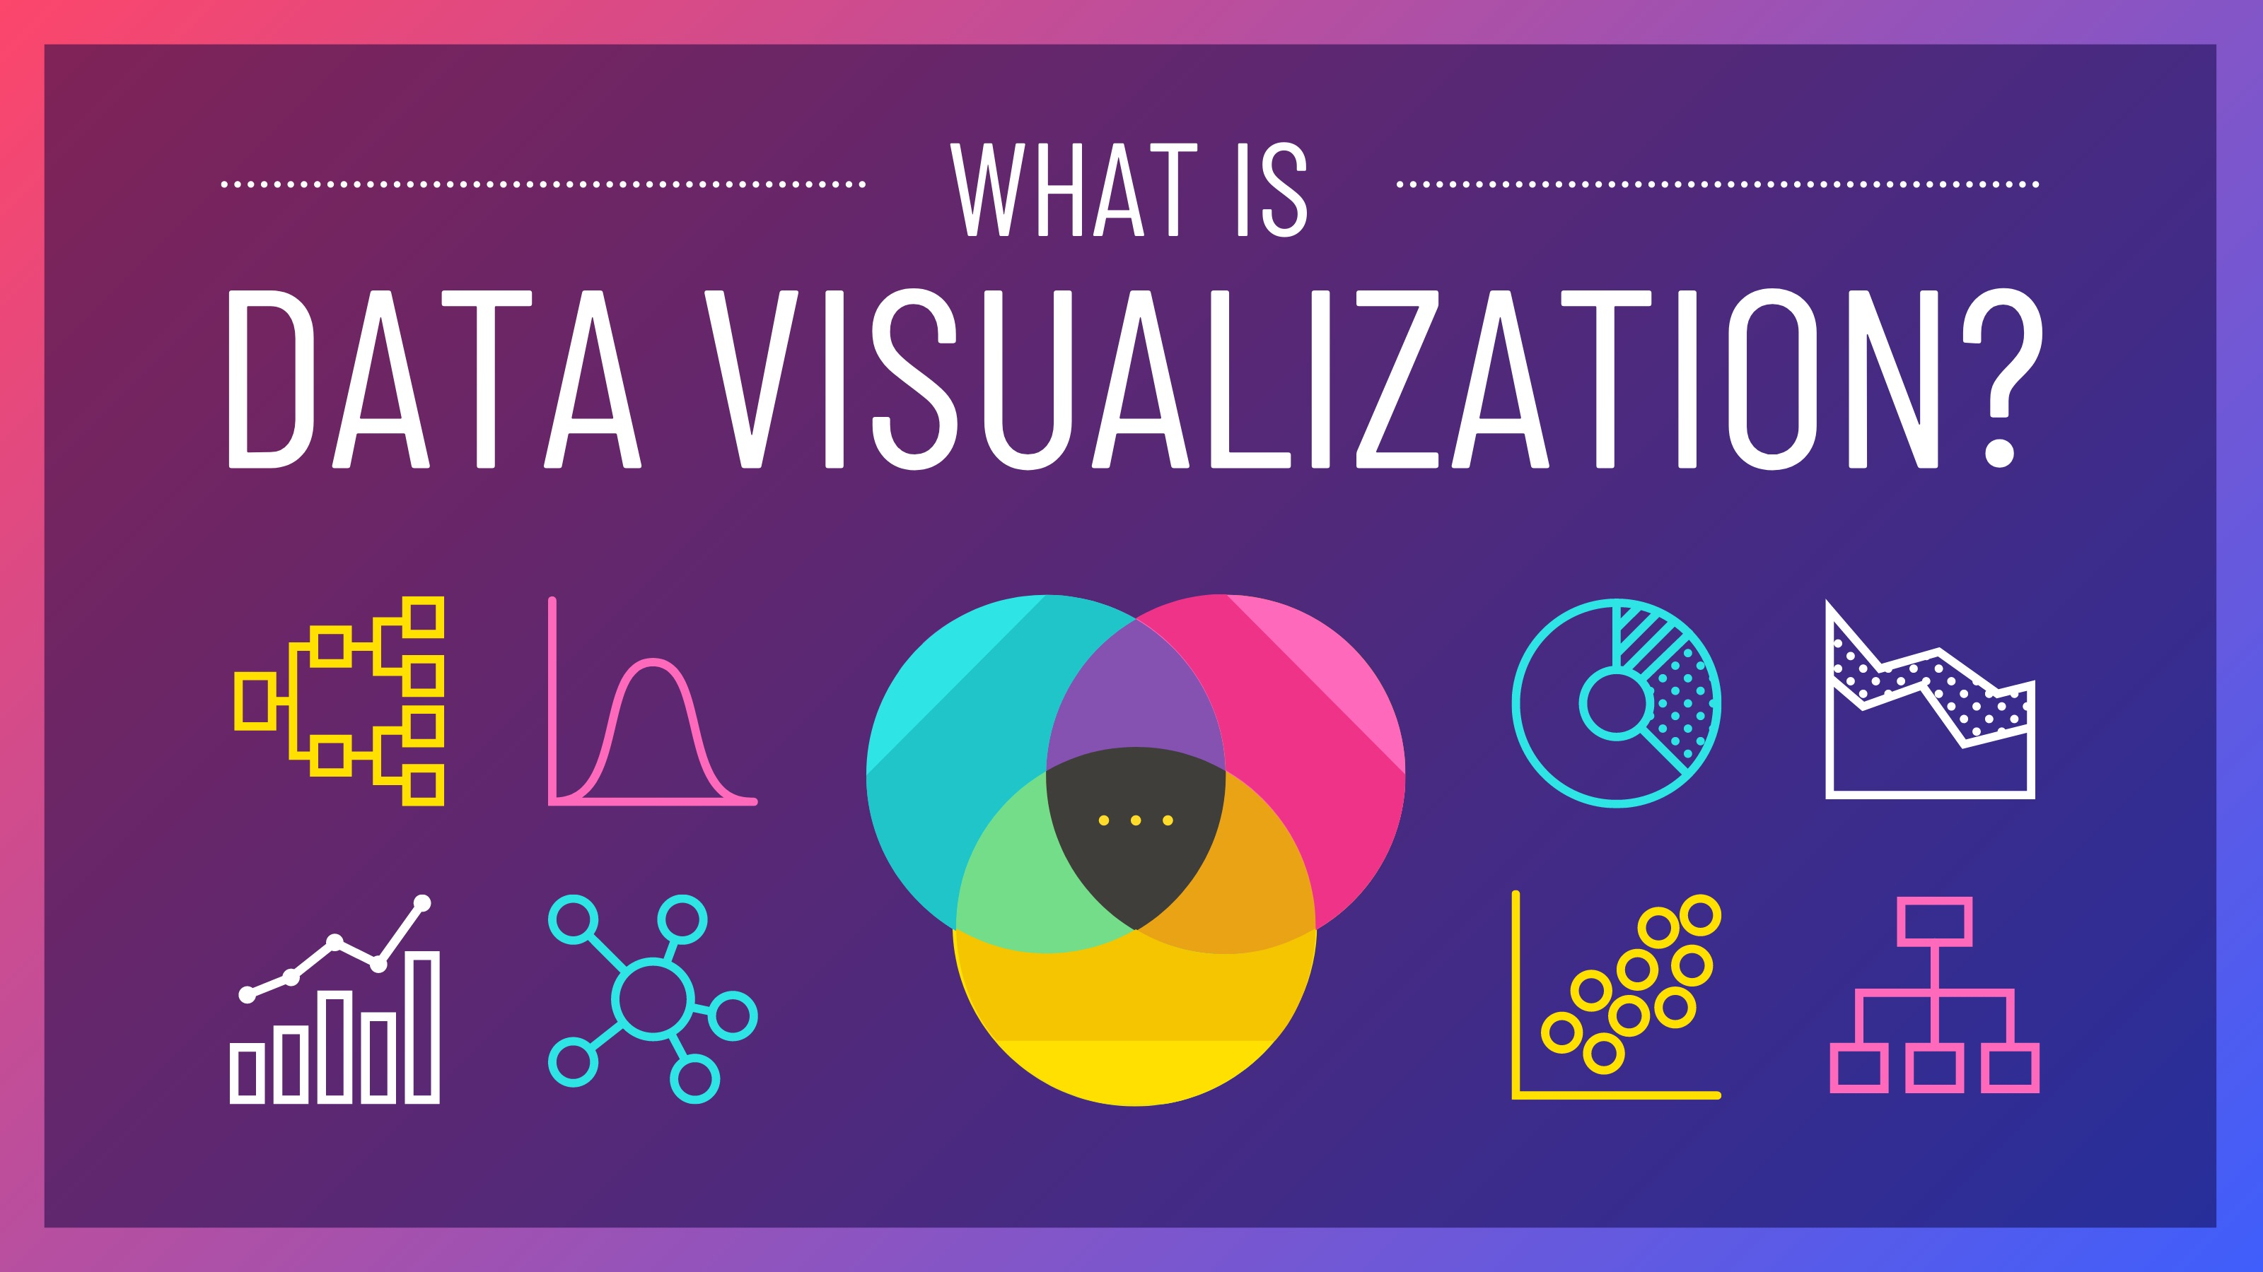
Notes:
Data visualization is the visual presentation of data or information. The goal of data visualization is to communicate data or information clearly and effectively to readers. Typically, data is visualized in the form of a chart, infographic, diagram or map.

Slide 6
Why do We Visualize Data?

Slide 7

Notes:
In this exercise we are going to take 3 seconds to try and identify which month has the highest number of sales for the year….
Are we ready?
Make it easier… Click

Slide 8
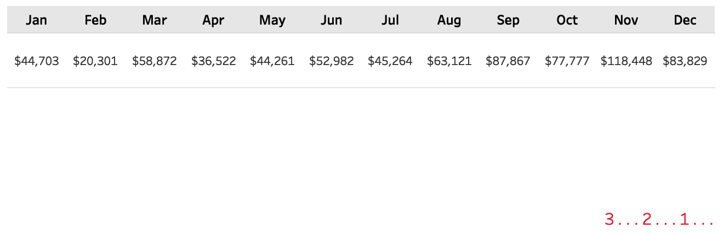

Slide 9

Notes:
Who can tell me which month had the highest number of sales?

Slide 10
Notes:
We are going to do this again but this time I want you to not just find one but the Top three performing months.
Are we ready?

Slide 12

Notes:
How many of you were able to identify the top 3 performing months?

Slide 13
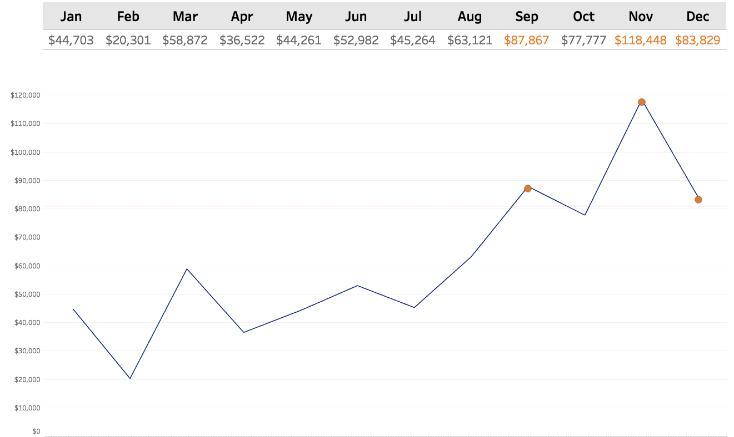
Notes:
So by visualizing the data and incorporating a few key pre-attentive attributes (like shape and color) I was able to effectively draw your eyes to the key places on the page where I wanted you to look.
Not only were you able to quickly identify data points of importance, you were also able to draw many other conclusions like: sales are steadily climbing, last 1/2 of the year out performed the first half.
The reason why we visualize data is so we can communicate information faster and make is easier to understand.

Slide 14
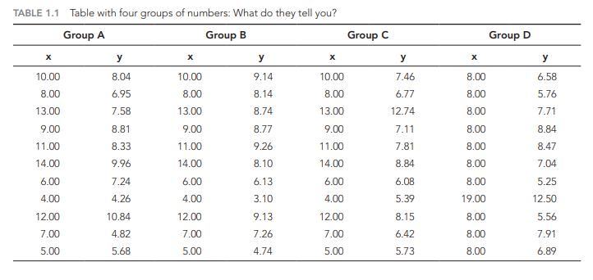
Why do We visualize data?
Notes:
We visualize data to harness the incredible power of our visual system to spot relationships and trends

Slide 15
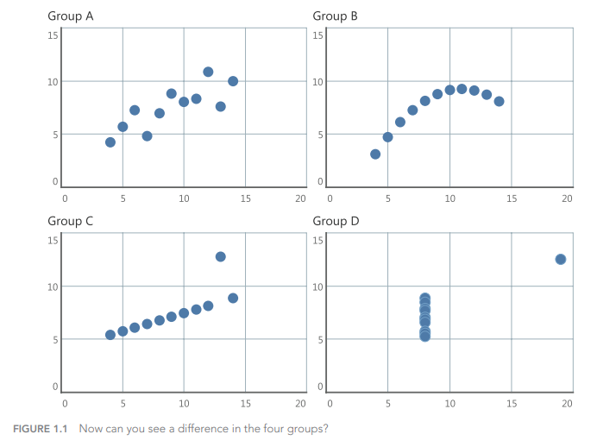
Why do We visualize data?
Notes:
We visualize data to harness the incredible power of our visual system to spot relationships and trends

Slide 16
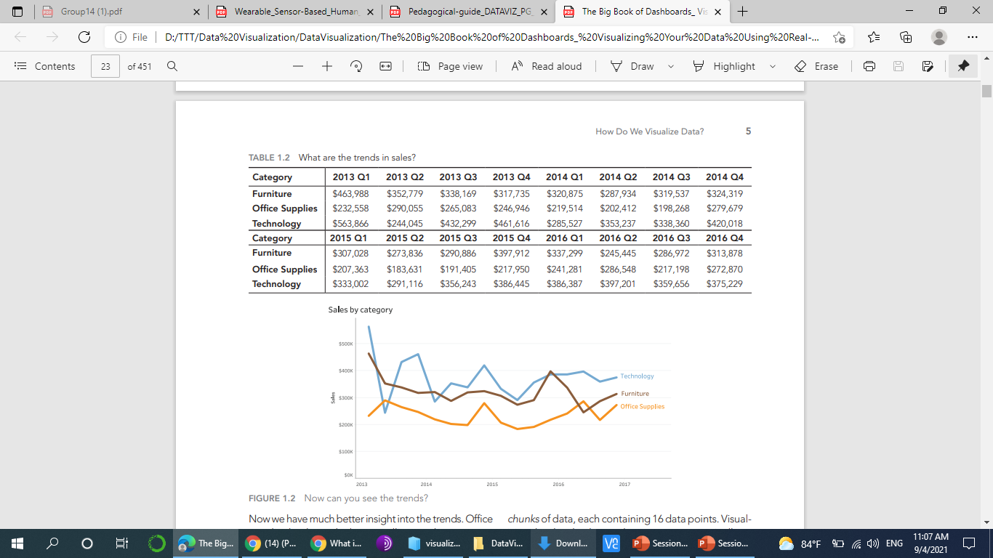
Memory Limits
48 numbers
3 Patterns
Notes:
Now we have much better insight into the trends. Office supplies has been the lowest-selling product category in all but two quarters. Furniture trends have been dropping slowly over the time period, except for a bump in sales in 2015 Q4 and a rise in the last two quarters. Technology sales have mostly been the highest but were particularly volatile at the start of the time period. The table and the line chart each visualized the same 48 data points, but only the line chart lets us see the trends. The line chart turned 48 data points into three chunks of data, each containing 16 data points. Visualizing the data hacks our short-term memory; it allows us to interpret large volumes of data instantly.

Slide 17
Why do We visualize data?
Making data engaging and easily digestible.
Identifying relationships, trends and outliers within a set of data.
Telling a story found within the data.
Reinforcing an argument or opinion.
Highlighting the important parts of a set of data.
Notes:
We visualize data to harness the incredible power of our visual system to spot relationships and trends.

Slide 18
How do We visualize data?
Notes:
what type of chart should I use to visualize my data? Does it matter?
Short answer: yes, it matters. Choosing a type of chart that doesn’t work with your data can end up misrepresenting and skewing your data.
The chart styles, colors, shapes, and sizing you use all play a role in how the data is interpreted. If you want to present your data accurately and ethically, then you need to take care to ensure that your data visualization does not present the data falsely.

Slide 19
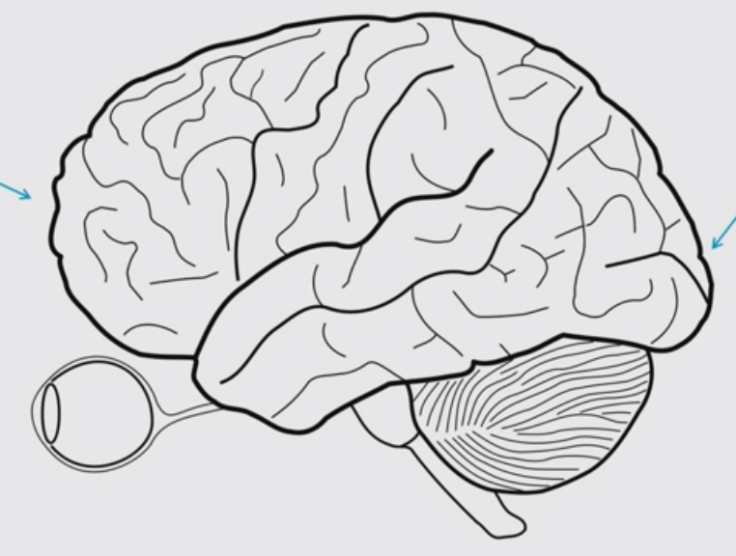
Thinking is Slow. Seeing is FAST
Thinking
Seeing

Slide 20
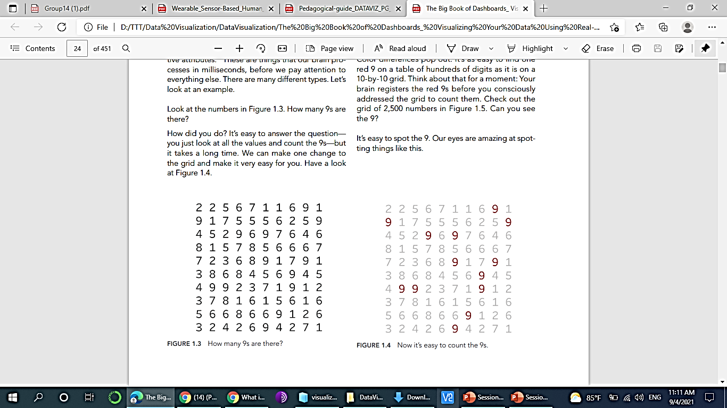
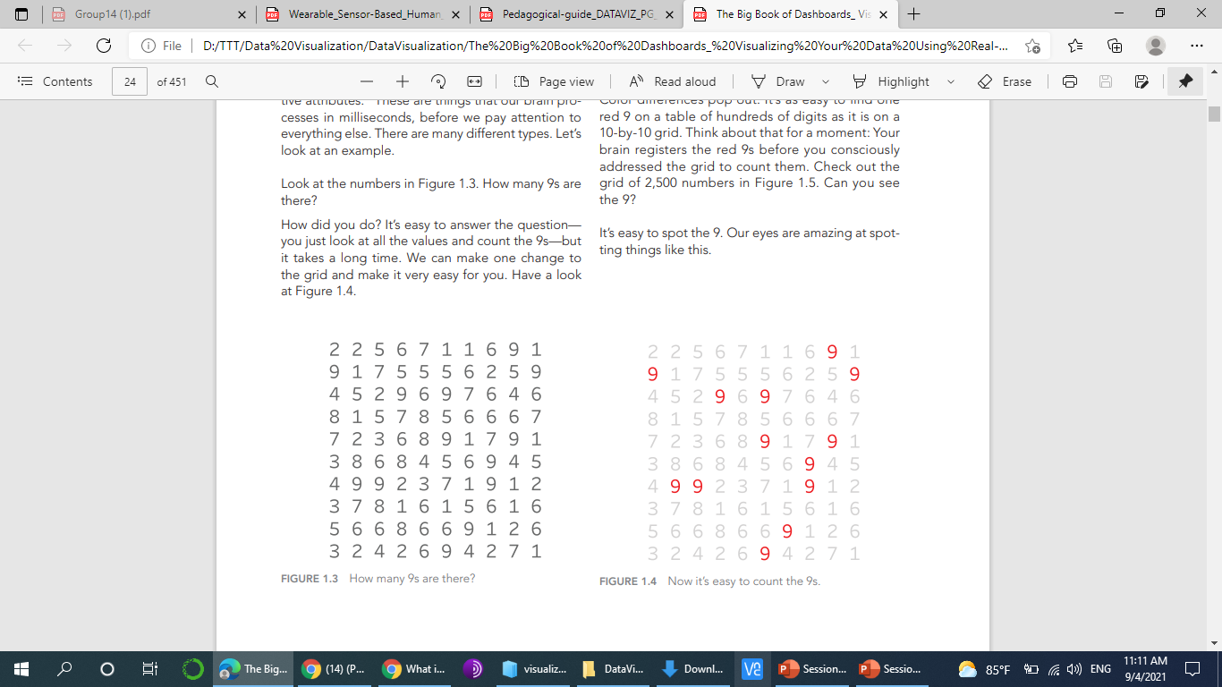
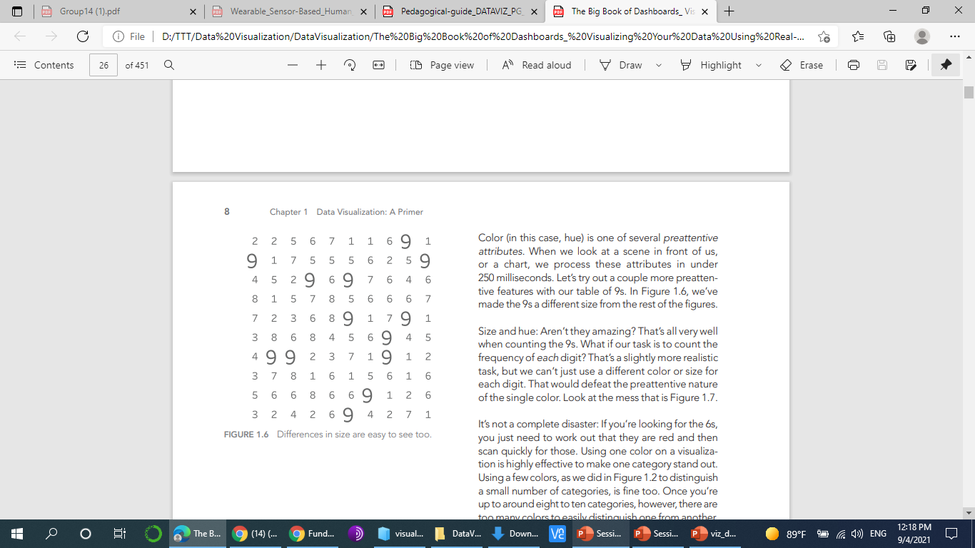
How many 9s are there?
Notes:
Size and hue: Aren’t they amazing? That’s all very well when counting the 9s. What if our task is to count the frequency of each digit? That’s a slightly more realistic task, but we can’t just use a different color or size for each digit. That would defeat the preattentive nature of the single color. Look at the mess that is Figure 1.7.
To count each digit, we need to aggregate. Visualization is, at its core, about encoding aggregations, such as frequency, in order to gain insight. We need to move away from the table entirely and encode the frequency of each digit. The most effective way is to use length, which we can do in a bar chart. Figure 1.8 shows the frequency of each digit. We’ve also colored the bar showing the number 9

Slide 21
How do We visualize data?
Now we need to move on to how we build the visualizations. To do that, we first need to look at two things:
Pre-attentive attributes
Types of data.

Slide 22

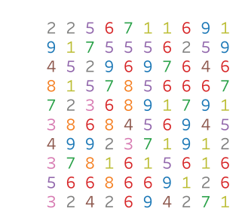
What if our task is to count the frequency of each digit?
Notes:
To count each digit, we need to aggregate. Visualization is, at its core, about encoding aggregations, such as frequency, in order to gain insight. We need to move away from the table entirely and encode the frequency of each digit. The most effective way is to use length, which we can do in a bar chart. Figure 1.8 shows the frequency of each digit. We’ve also colored the bar showing the number 9. Since the task is to count the 9s in the data source, the bar chart is one of the best ways to see the results. This is because length and position are best for quantitative comparisons. If we extend the example one final time and consider which numbers are most common, we could sort the bars, as shown in Figure 1.9
n the sorted bar chart, not only can we count the 9s (the original task), but we also know that 9 was the third most common digit in the table. We can also see the frequency of every other digit.
The series of examples we just presented used color, size, and length to highlight the 9s. These are three of many preattentive attributes. Figure 1.10 shows 12 that are commonly used in data visualizatio

Slide 23
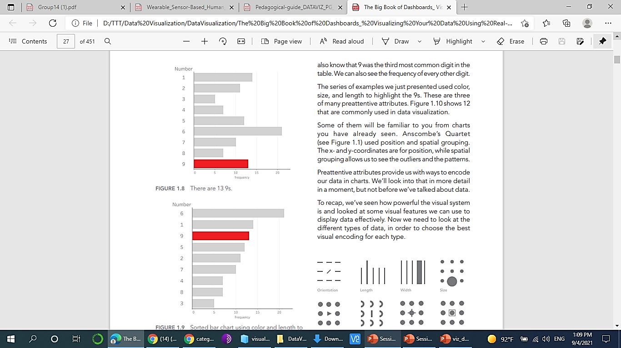
What if our task is to count the frequency of each digit?
Notes:
To count each digit, we need to aggregate. Visualization is, at its core, about encoding aggregations, such as frequency, in order to gain insight. We need to move away from the table entirely and encode the frequency of each digit. The most effective way is to use length, which we can do in a bar chart. Figure 1.8 shows the frequency of each digit. We’ve also colored the bar showing the number 9. Since the task is to count the 9s in the data source, the bar chart is one of the best ways to see the results. This is because length and position are best for quantitative comparisons. If we extend the example one final time and consider which numbers are most common, we could sort the bars, as shown in Figure 1.9
n the sorted bar chart, not only can we count the 9s (the original task), but we also know that 9 was the third most common digit in the table. We can also see the frequency of every other digit.
The series of examples we just presented used color, size, and length to highlight the 9s. These are three of many preattentive attributes. Figure 1.10 shows 12 that are commonly used in data visualizatio

Slide 24
Pre-Attentive Attributes
Visualizing data requires us to turn data into marks on a canvas.
What kind of marks make the most sense?
One answer lies in what are called “pre-attentive attributes.”
These are things that our brain processes in milliseconds, before we pay attention to everything else.
Pre-attentive attributes provide us with ways to encode our data in charts.

Slide 25
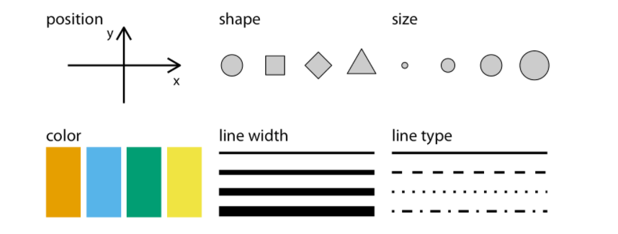
Pre-Attentive Attributes Types
Notes:
Commonly used aesthetics in data visualization: position, shape, size, color, line width, line type. Some of these aesthetics can represent both continuous and discrete data (position, size, line width, color) while others can usually only represent discrete data (shape, line type).

Slide 26
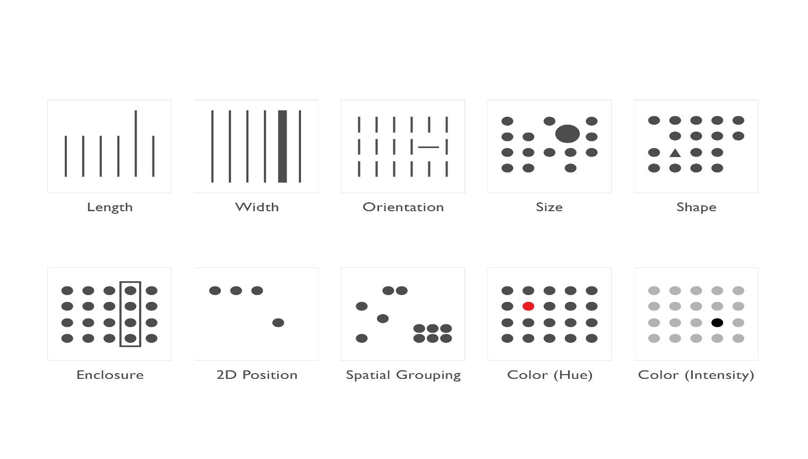
Pre-Attentive Attributes Types
Length | Width | Orientation | Size | Shape
Enclosure | 2D Position | Grouping | Color (Hue) | Color (Intensity)
Notes:
Using pre-attentive principles in your dashboards allow your end user to process information faster and draw clear distinctions in the data. It gives you the ability to say more with less.
So whether you choose to draw these lines of distinction by using size, shape, width, or color; your end user will be able to better understand the message being delivered
Be mindful when using these principles as the brain is able to distinguish the differences in some better than others.
Let me show you what I mean…

Slide 27
What is different?

Slide 28
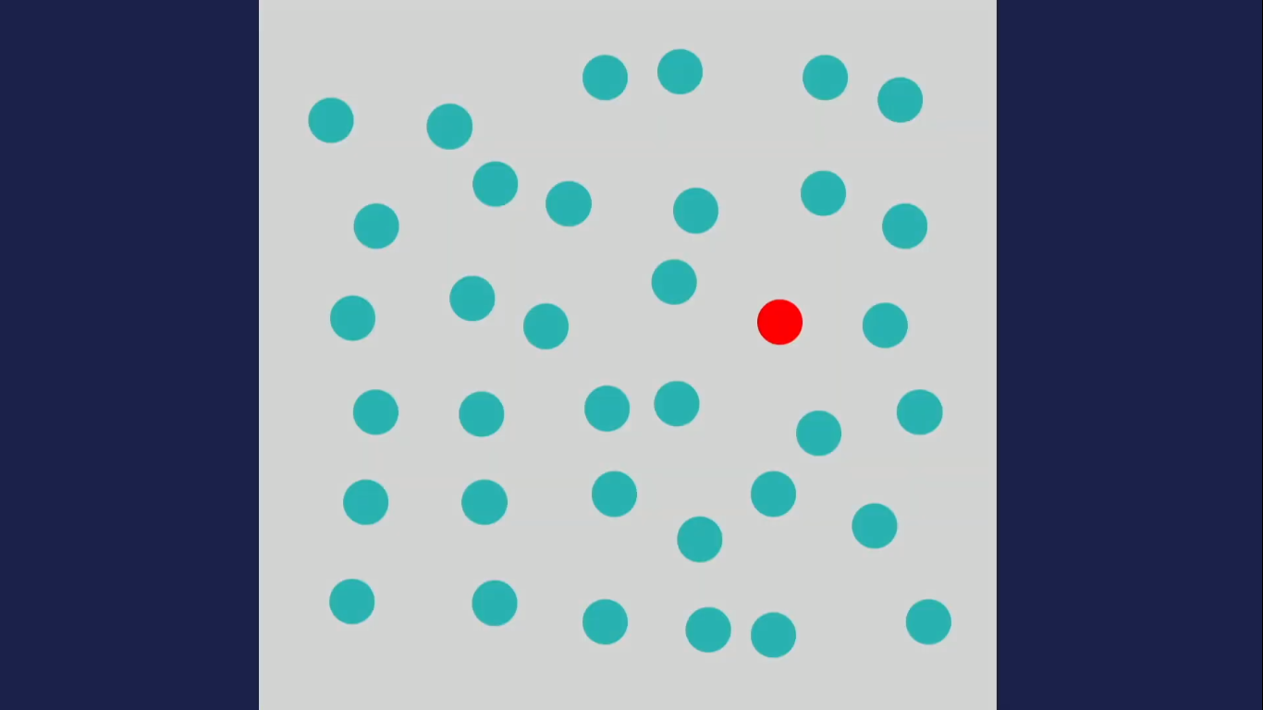

Slide 30
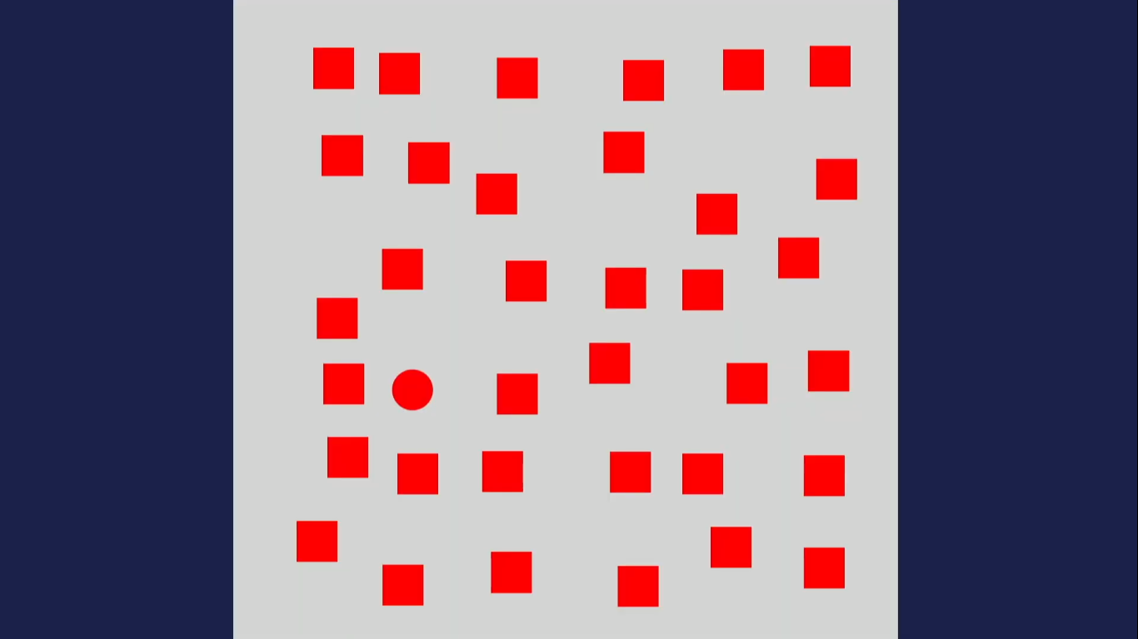

Slide 32
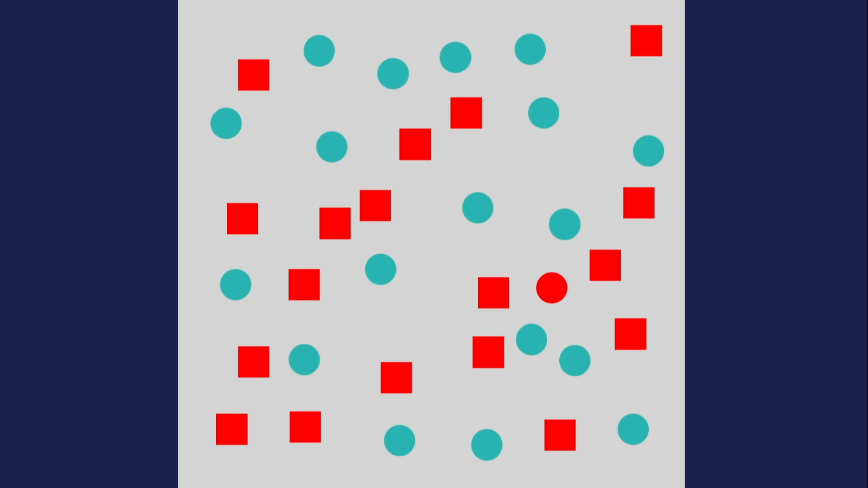

Slide 33
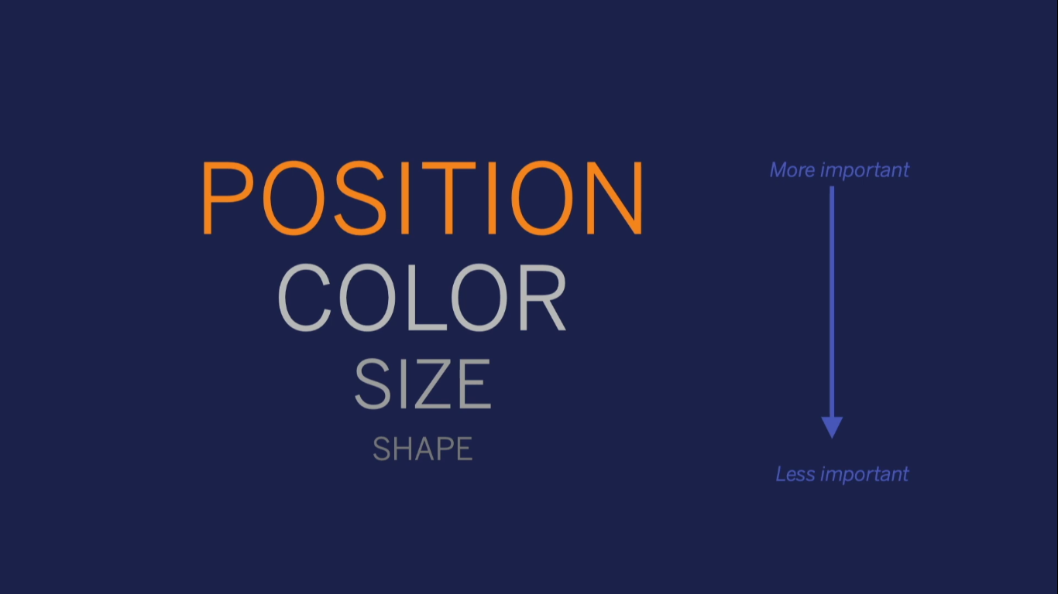
How Do Human Like Their Data?

Slide 34
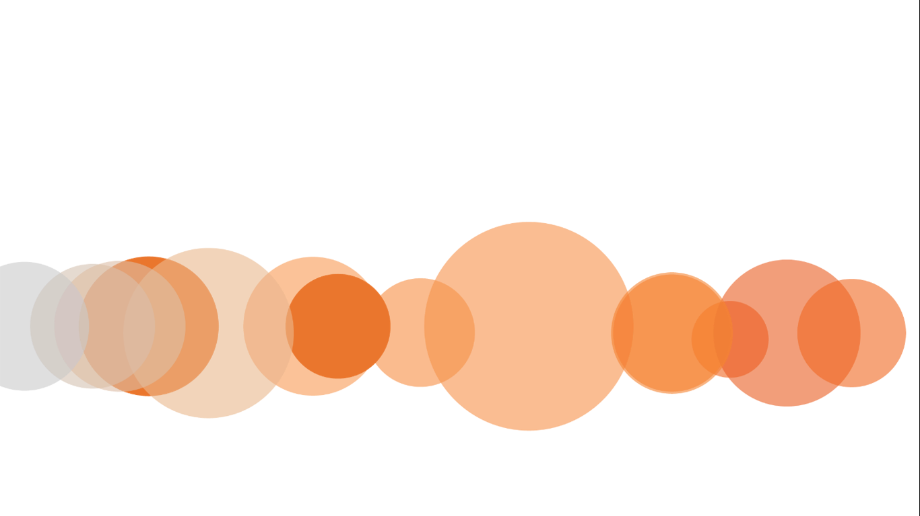
Data Types
Notes:
There are three types of data:
categorical, ordinal, and quantitative

Slide 35
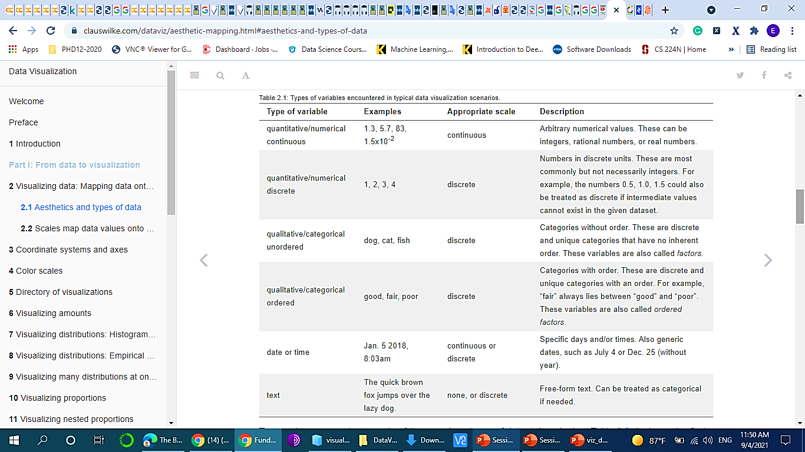

Slide 36

Series Dataset
7 season
each season has 25 episode
each episode has a rating

Slide 37
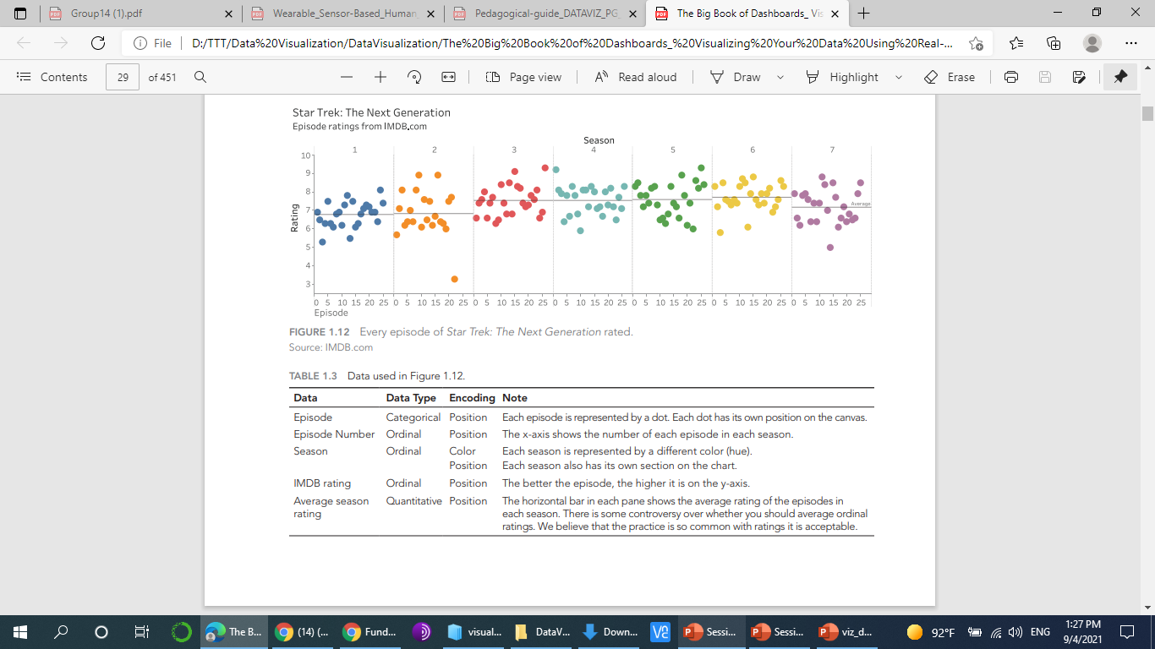
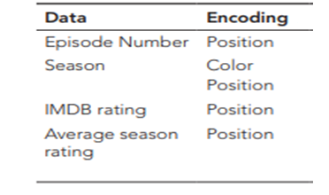
Encoding Data in Charts
Notes:
We’ve now looked at preattentive attributes and the three types of data. It’s time to see how to combine that knowledge into building charts. Let’s look at some charts and see how they encode the different types of data

Slide 39
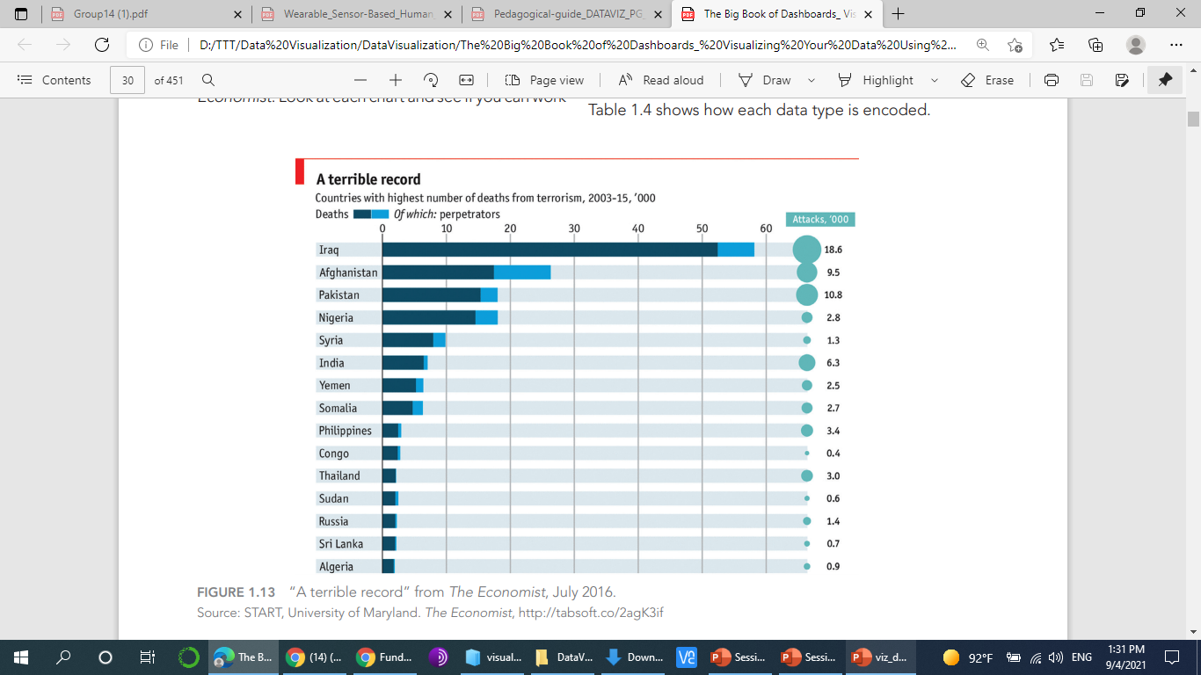
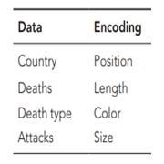
Encoding Data in Charts

Slide 40
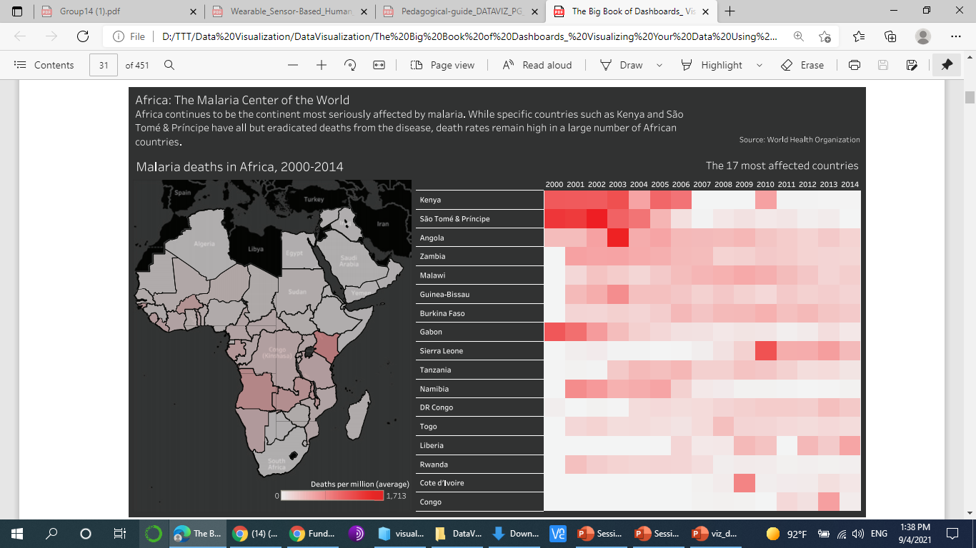
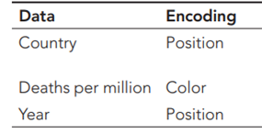
Encoding Data in Charts

Slide 41
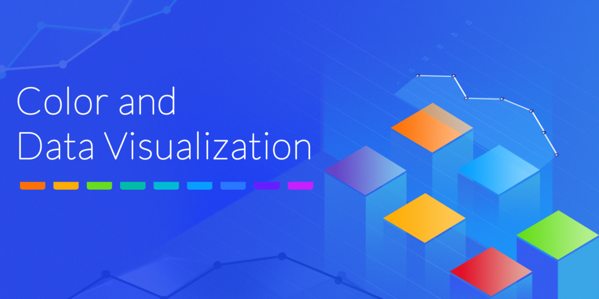

Notes:
Color is one of the most important things to understand in data visualization and frequently is misused. You should not use color just to spice up a boring visualization. In fact, many great data visualizations don’t use color at all and are informative and beautiful. Color is one of the most important things to understand in data visualization and frequently is misused. You should not use color just to spice up a boring visualization. In fact, many great data visualizations don’t use color at all and are informative and beautiful. Color is one of the most important things to understand in data visualization and frequently is misused. You should not use color just to spice up a boring visualization. In fact, many great data visualizations don’t use color at all and are informative and beautiful.

Slide 42


Slide 43


Slide 44
Color in Data Visualizations
There are three fundamental use cases for color in data visualizations:
Distinguish groups of data from each other
Represent data values
Highlight.
Notes:
For example, color can be used to draw the attention of the reader, highlight a portion of data, or distinguish between different categories.
The types of colors we use and the way in which we use them are quite different for these three cases.

Slide 45
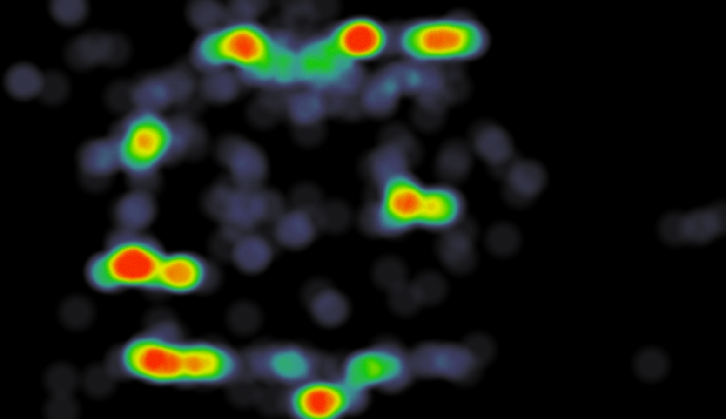
Color in Data Visualizations
Notes:
Use colors strategically in your design
In design, colors are as functional as they are fashionable. You can use colors to emphasize points, categorize information, show movement or progression, and more.
Misleading Color Contrast
Color is among the most persuasive design elements. Even subtle shade variations elicit strong emotional responses. In data visualization, high degrees of color contrast may cause viewers to believe that value disparities are greater than they really are.
For example, heatmaps depict value magnitude with color. High values appear orange and red, while lower values are rendered in blue and green. The difference between values may be minimal, but color contrast creates the impression of heat and heightened activity.
Color is more than a way to differentiate between data series.
High-contrast color pairings cause viewers to perceive greater degrees of data disparity.
The most comprehensive and empowering uses of data visualization not only tell the story but also allow the audience to view and draw insights, identify correlations, recognize trends, and, ultimately, form their own fact-based story. These data-driven stories provide decision makers with an opportunity to make efficient, informed decisions in a way that might not be possible with textual data alone. Data analytics—or simply reporting information—without effective visualization can lead to a great risk of the audience getting “lost in the data.” This can prolong decision making or, worse, lead to decisions that aren’t supported by the data. This risk can be mitigated through pairing data visualization tools and best practices.

Slide 46
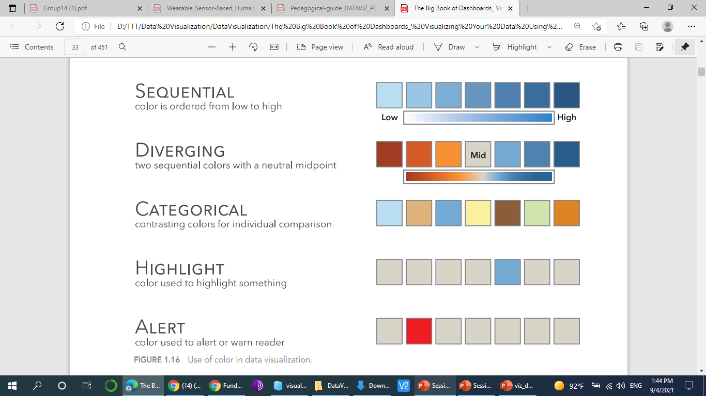
Color Scales

Slide 47
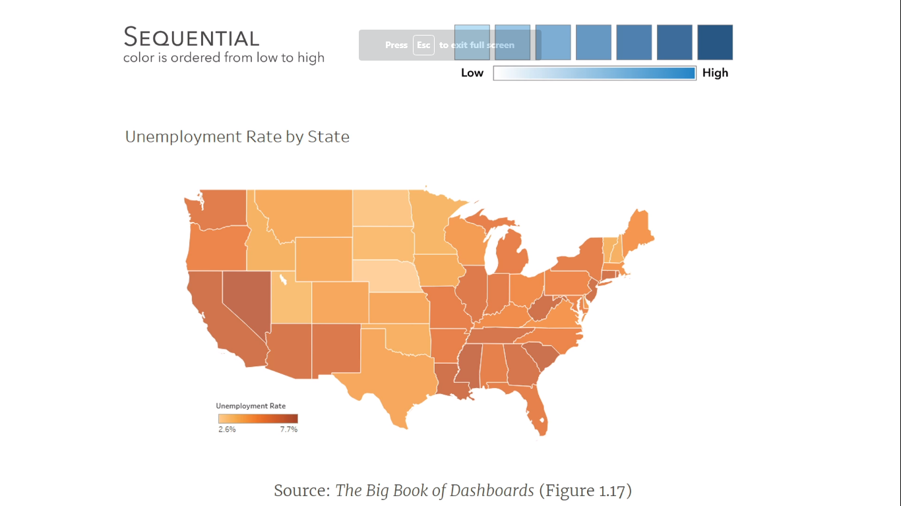
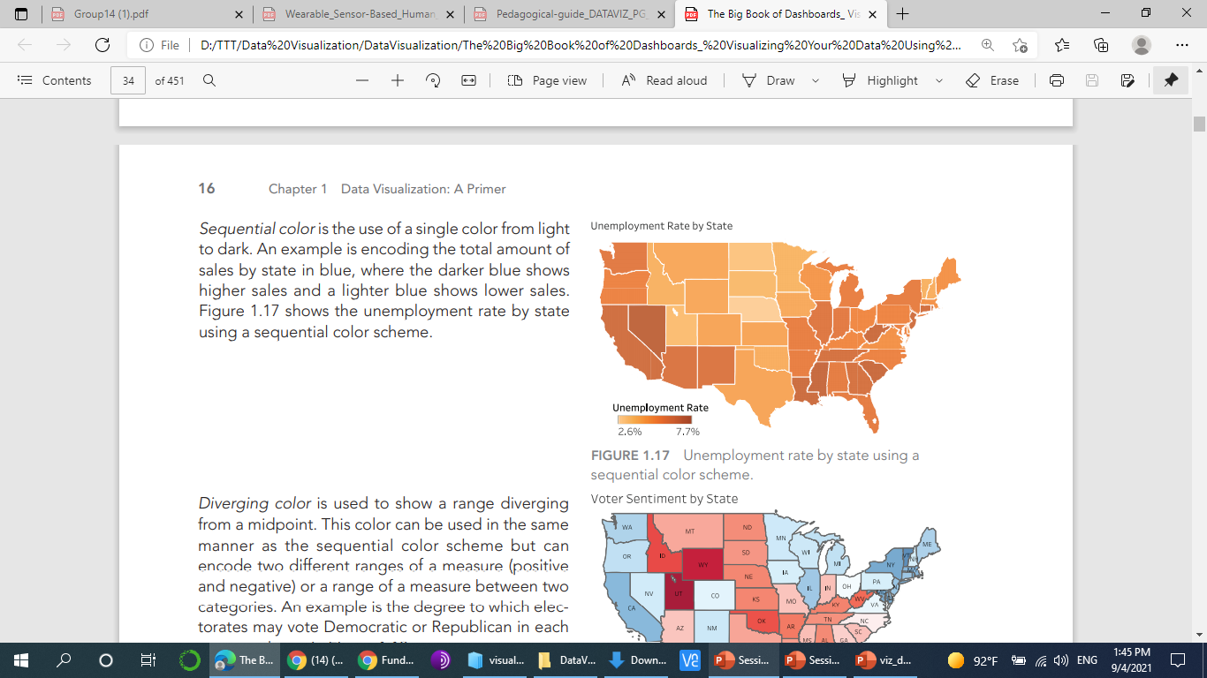
Sequential color
Notes:
Sequential color is the use of a single color from light to dark. An example is encoding the total amount of sales by state in blue, where the darker blue shows higher sales and a lighter blue shows lower sales. Figure 1.17 shows the unemployment rate by state using a sequential color scheme.

Slide 48
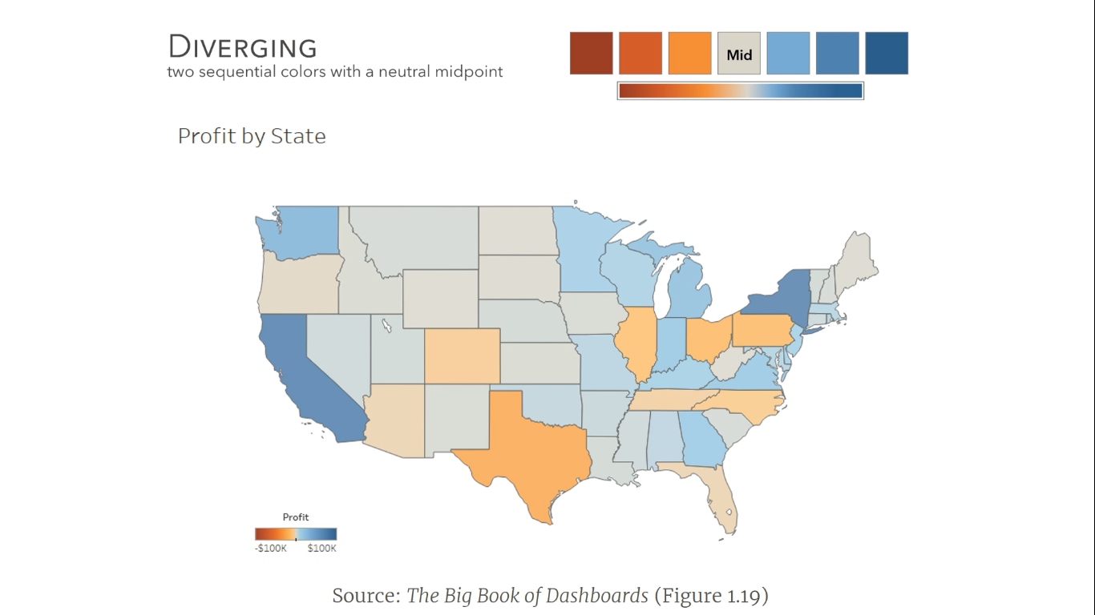
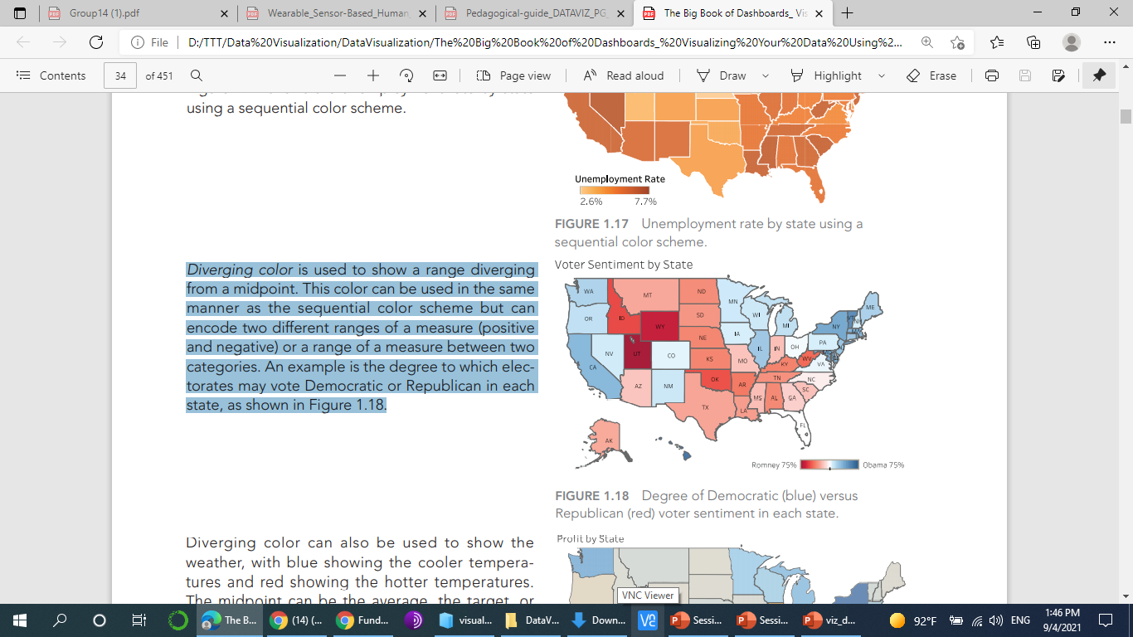
Diverging color
Notes:
Diverging color is used to show a range diverging from a midpoint. This color can be used in the same manner as the sequential color scheme but can encode two different ranges of a measure (positive and negative) or a range of a measure between two categories. An example is the degree to which electorates may vote Democratic or Republican in each state, as shown in Figure 1.18.

Slide 49
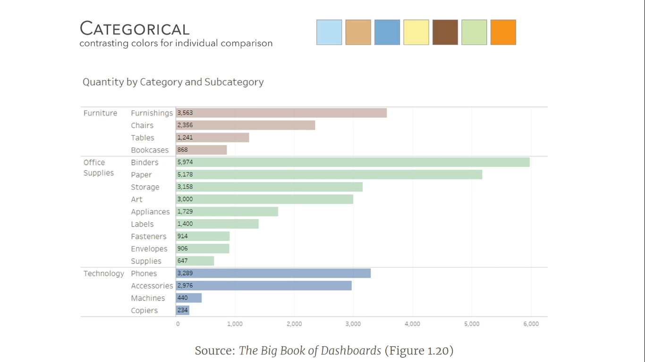
Categorical color
Notes:
Categorical color uses different color hues to distinguish between different categories. For example, we can establish categories involving apparel (e.g., shoes, socks, shirts, hats, and coats) or vehicle types (e.g., cars, minivans, sport utility vehicles, and motorcycles). Figure 1.20 shows quantity of office supplies in three categories.

Slide 50
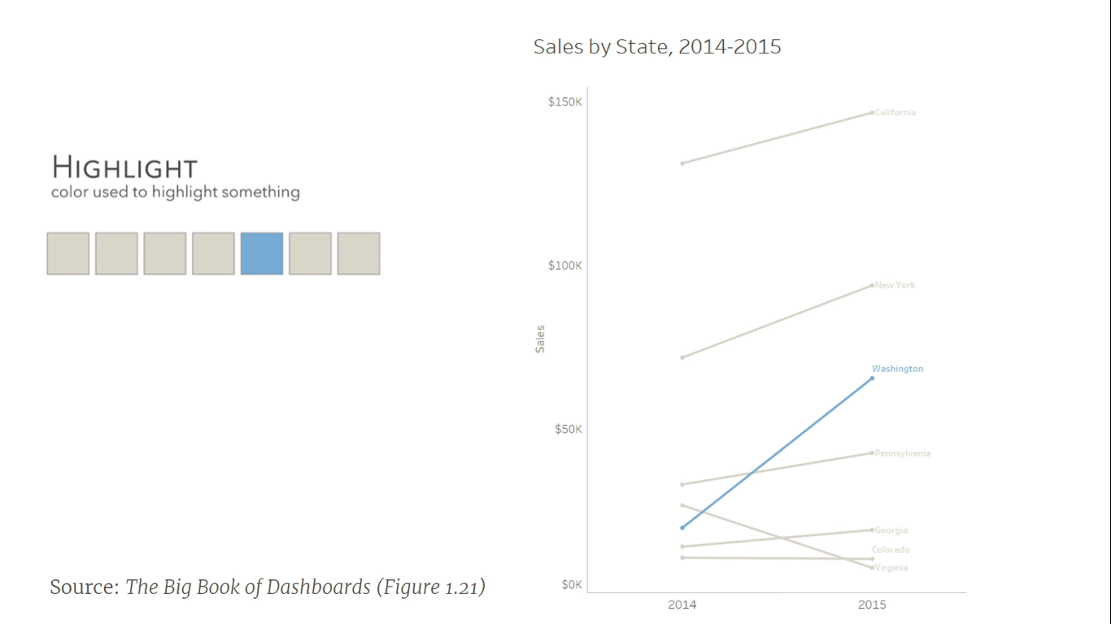
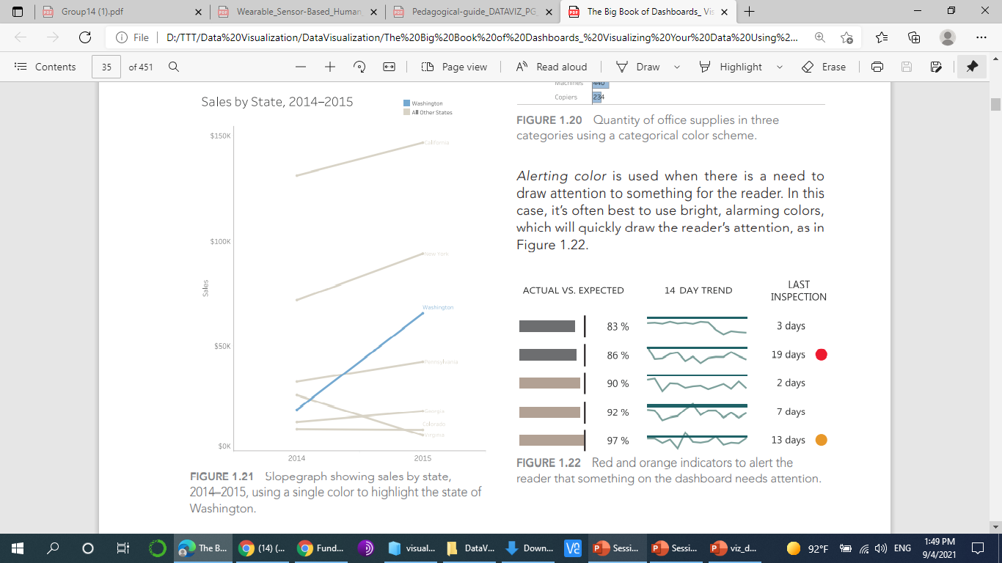
Highlight color
Notes:
Highlight color is used when there is something that needs to stand out to the reader, but not alert or alarm them. Highlights can be used in a number of ways, as in highlighting a certain data point, text in a table, a certain line on a line chart, or a specific bar in a bar chart. Figure 1.21 shows a slopegraph with a single state highlighted in blue.

Slide 51
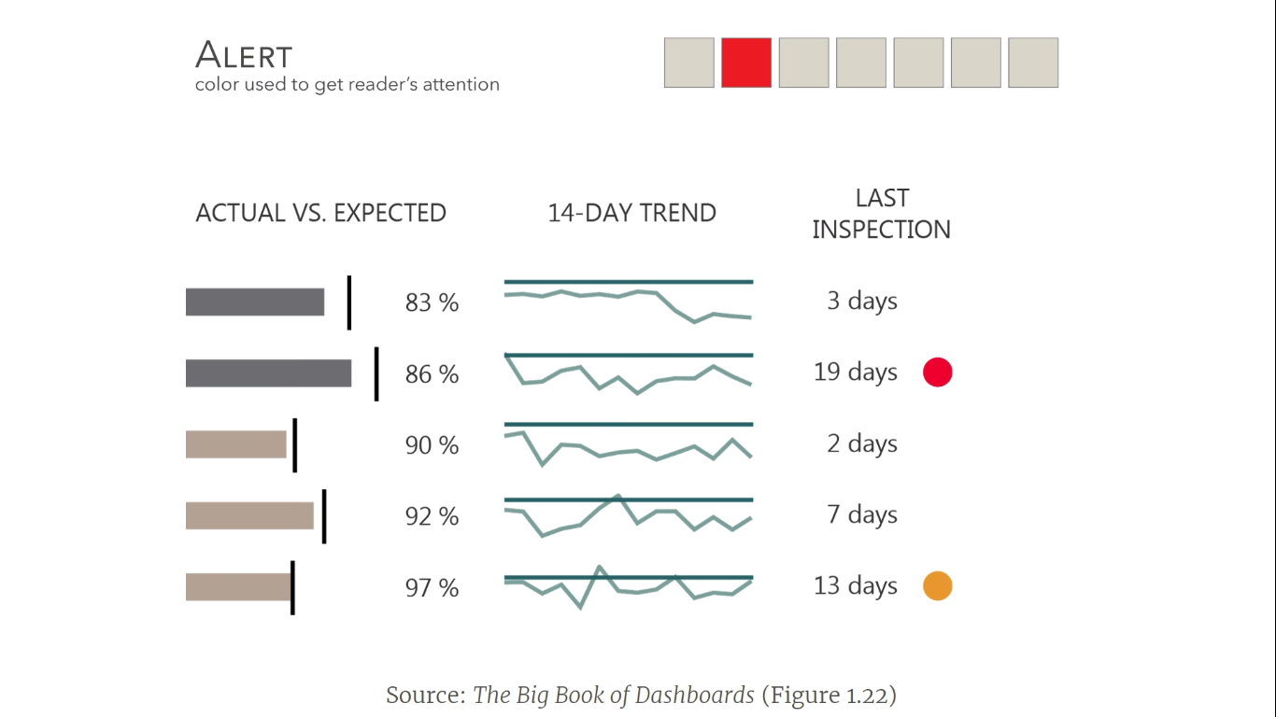
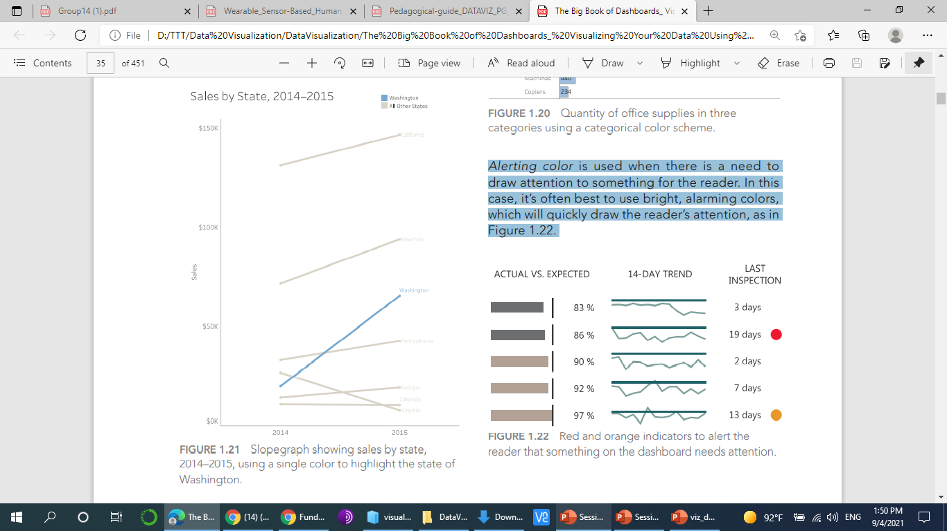
Alerting color
Notes:
Alerting color is used when there is a need to draw attention to something for the reader. In this case, it’s often best to use bright, alarming colors, which will quickly draw the reader’s attention, as in Figure 1.22.

Slide 52
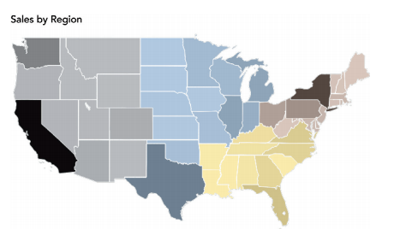
Categorical-sequential color scheme
Notes:
It is also possible to have a categorical-sequential color scheme. In this case, each category has a distinct hue that is darker or lighter depending on the measurement it is representing. Figure 1.23 shows an example of a four-region map using categorical colors (i.e., gray, blue, yellow, and brown) but at the same time encoding a measure in those regions using sequential color; let’s assume that sales are higher in states with darker shading.

Slide 53
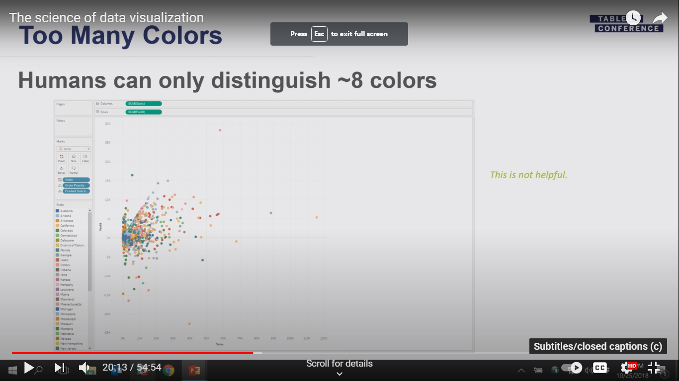
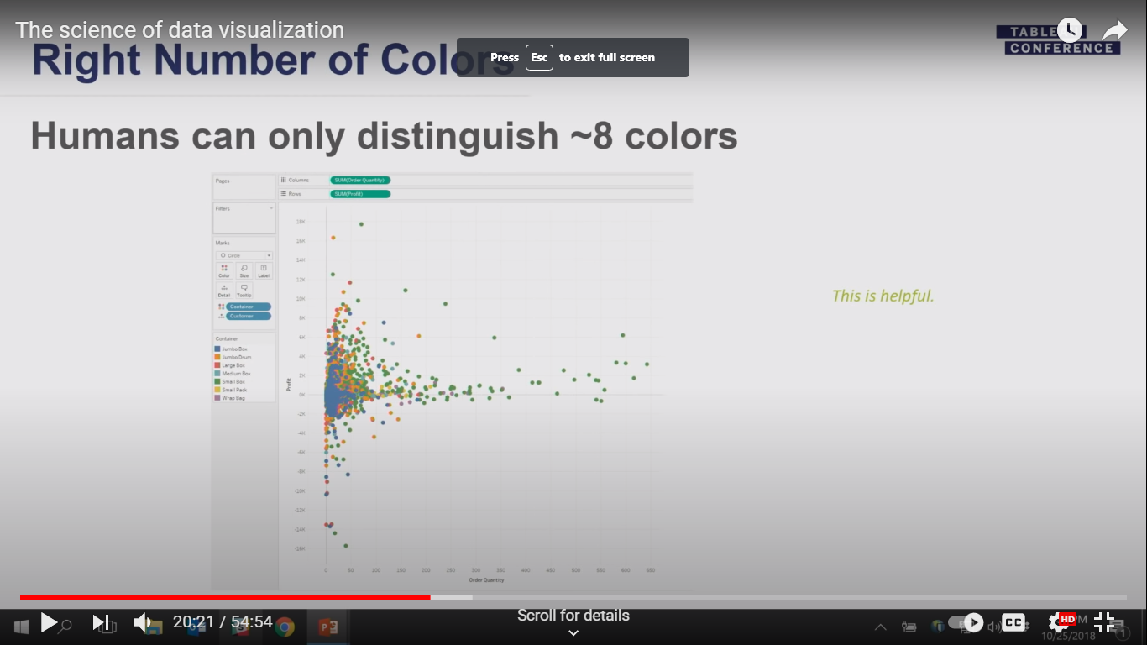
Too Many Colors

Slide 54
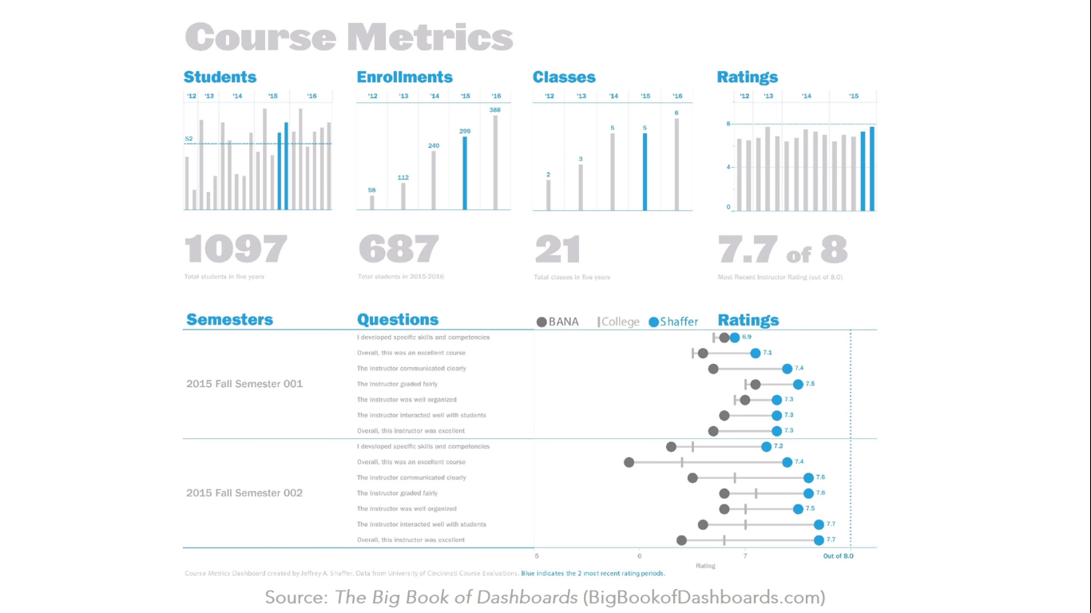

Slide 55
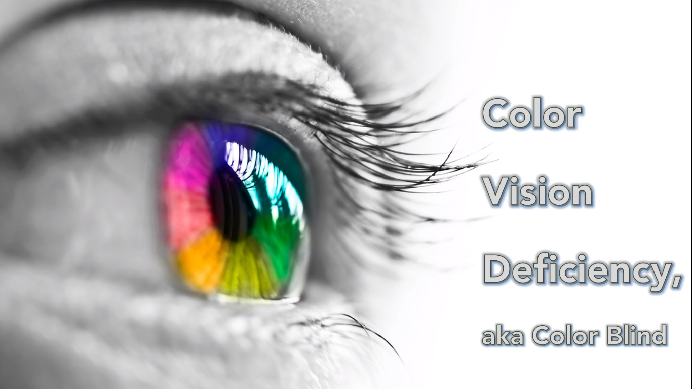

Slide 56
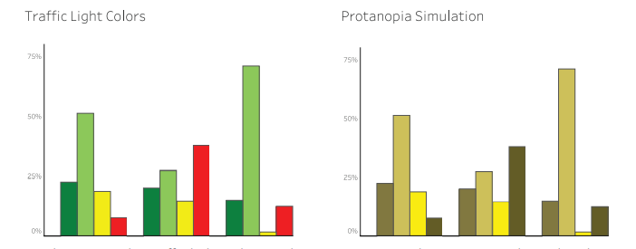
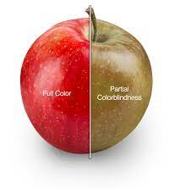
Color Blindness
The primary problem among people with CVD is with the colors red and green.
This is why it is best to avoid using red and green together and, in general, to avoid the commonly used traffic light colors.
Notes:
Bar chart using the traffic light colors and a protanopia simulation. Notice the red and green bars in the panel on the right are very difficult to differentiate from one another for a person with protanopia.
Figure 1.25 Bar chart using a color-blind-friendly blue and orange palette and a protanopia simulation.

Slide 57
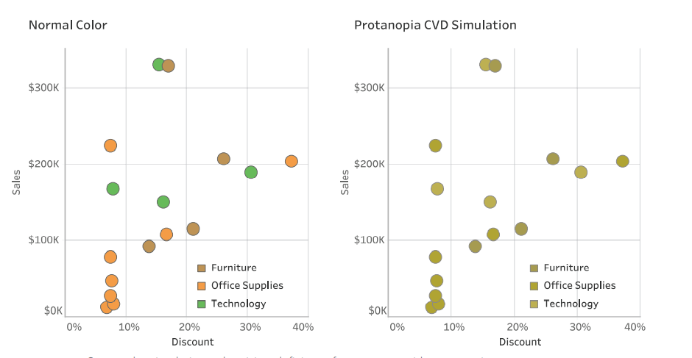
Color Blindness
Notes:
Bar chart using the traffic light colors and a protanopia simulation. Notice the red and green bars in the panel on the right are very difficult to differentiate from one another for a person with protanopia.
Figure 1.25 Bar chart using a color-blind-friendly blue and orange palette and a protanopia simulation.

Slide 58
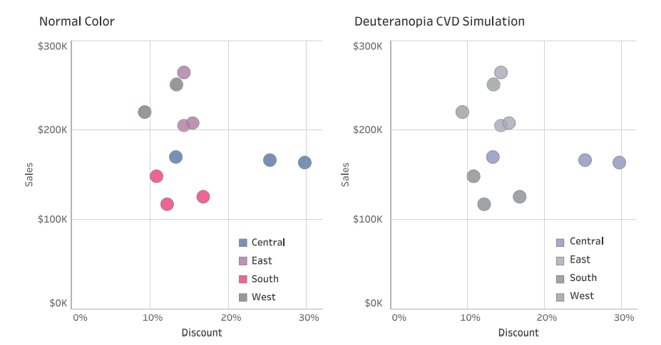
Color Blindness
Notes:
Bar chart using the traffic light colors and a protanopia simulation. Notice the red and green bars in the panel on the right are very difficult to differentiate from one another for a person with protanopia.
Figure 1.25 Bar chart using a color-blind-friendly blue and orange palette and a protanopia simulation.

Slide 59
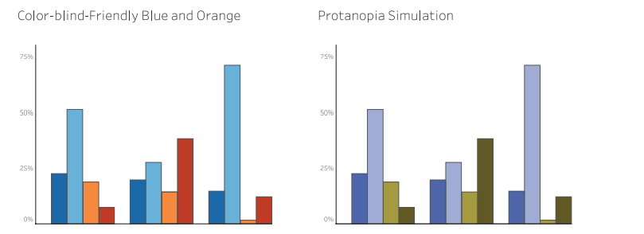
Color Blindness

Slide 60
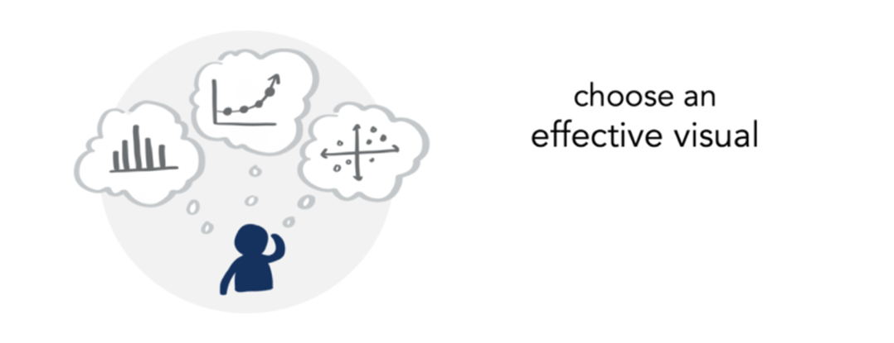

Slide 61
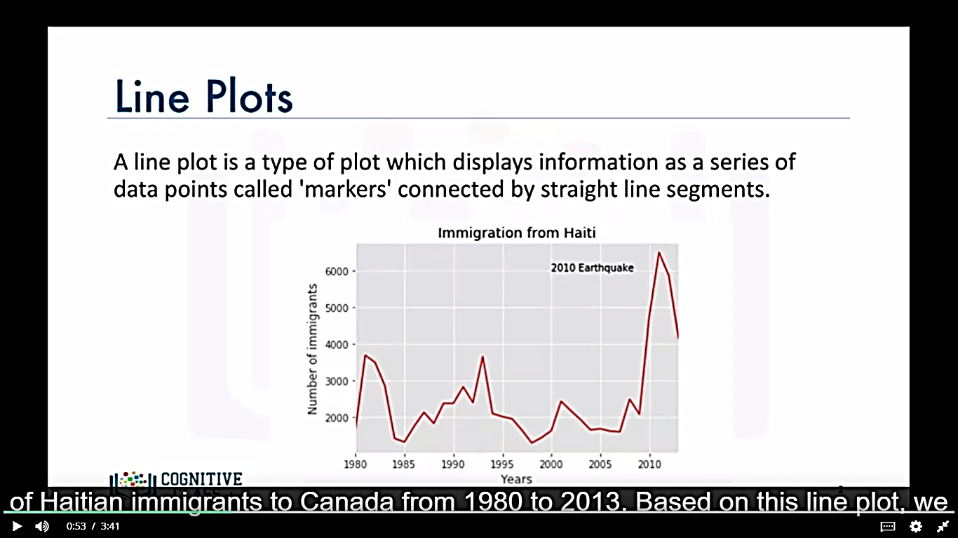
Line plots
A line plot is a type of plot which displays information as a series of data points called ‘markers’ connected by straight line segments.
The best use case for line plot is when you have a continuous dataset and you are interested in visualizing the data over a period of time.

Slide 62

Area Plots
An extension of line plots.
Commonly used to represent and Compare cumulated totals using numbers or percentage over time.
Notes:
Compare two or more quantities

Slide 63

Bar Charts
Unlike a histogram, a bar chart is commonly used to compare the values of a variable at a given point in time.

Slide 64

Pie Charts
Is a circular statistical graphic divided into slices to illustrate numerical proportion.
Don’t use it

Slide 65


Can you order the slices from biggest to smallest?
Notes:
Let’s look at another pie. The biggest slice in Figure 1.45 is easy to spot. But what about the second, third, and fourth biggest slices?
That was really hard. Now look at the same data, shown in a bar chart, in Figure 1.46. The sorted bar chart made it very easy to distinguish size differences: Length is such an effective visual attribute, we can see very small differences with ease. To make effective dashboards, you must resist the temptation to use purely decorative chart types.

Slide 66

Histograms
Is a way of representing the frequency of the distribution of a numeric dataset.
It partitions the spread of the numeric data into bins, assign each datapoint in the dataset to a bin, and then count the numbers of datapoints that have assigned to each bin.

Slide 67


Box Plots
A boxplot is a way of statistically representing the distribution of a given data through 5 main dimensions.

Slide 68


Scatter Plots
Displays values pertaining to typically two variables against each other.
Usually it is a dependent variable to be plotted against independent variable in order to determine if any correlation between the two variables exists.

Slide 69

Do I have the right chart?
Notes:
We explain in the scenarios why many of the charts were chosen to fulfill a particular task. In this section, we briefly outline the most common chart types

Slide 70
From data to Viz | Find the graphic you need (data-to-viz.com)
List View: The Data Visualisation Catalogue (datavizcatalogue.com)
charts and graphs - a complete guide — storytelling with data
Datawrapper Blog

